Slide 1
Scene generation for AI based thermal imaging system

Slide 2
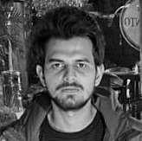
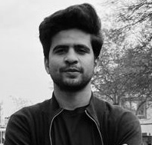

Group Members
Muhammad Abbad
Shabih Ul Hassan
Hamza Amin
(18I-0470)
(18I-0640)
(18I-0550)

Slide 3
INTRODUCTION
Type of Project :
Development
Supervisor :
Dr. Hammad Majeed
Co-supervisor :
Mr. Umair Arshad
Co-supervisor (external):
Dr. Adeel Mumtaz

Slide 4

Project Overview
AI based thermal imaging
Real time flight simulation
Generate scene or test thermal AI systems
Working AI based target detection system
Online testing at NESCOM

Slide 5

Iteration - I
Selection of Terrain
Selection of Target
Switch between different camera views

Slide 6
ITERATION - II

Slide 7
Use Cases - Iteration II
Developing an application
Selection of trajectory
Scene Generation

Slide 8
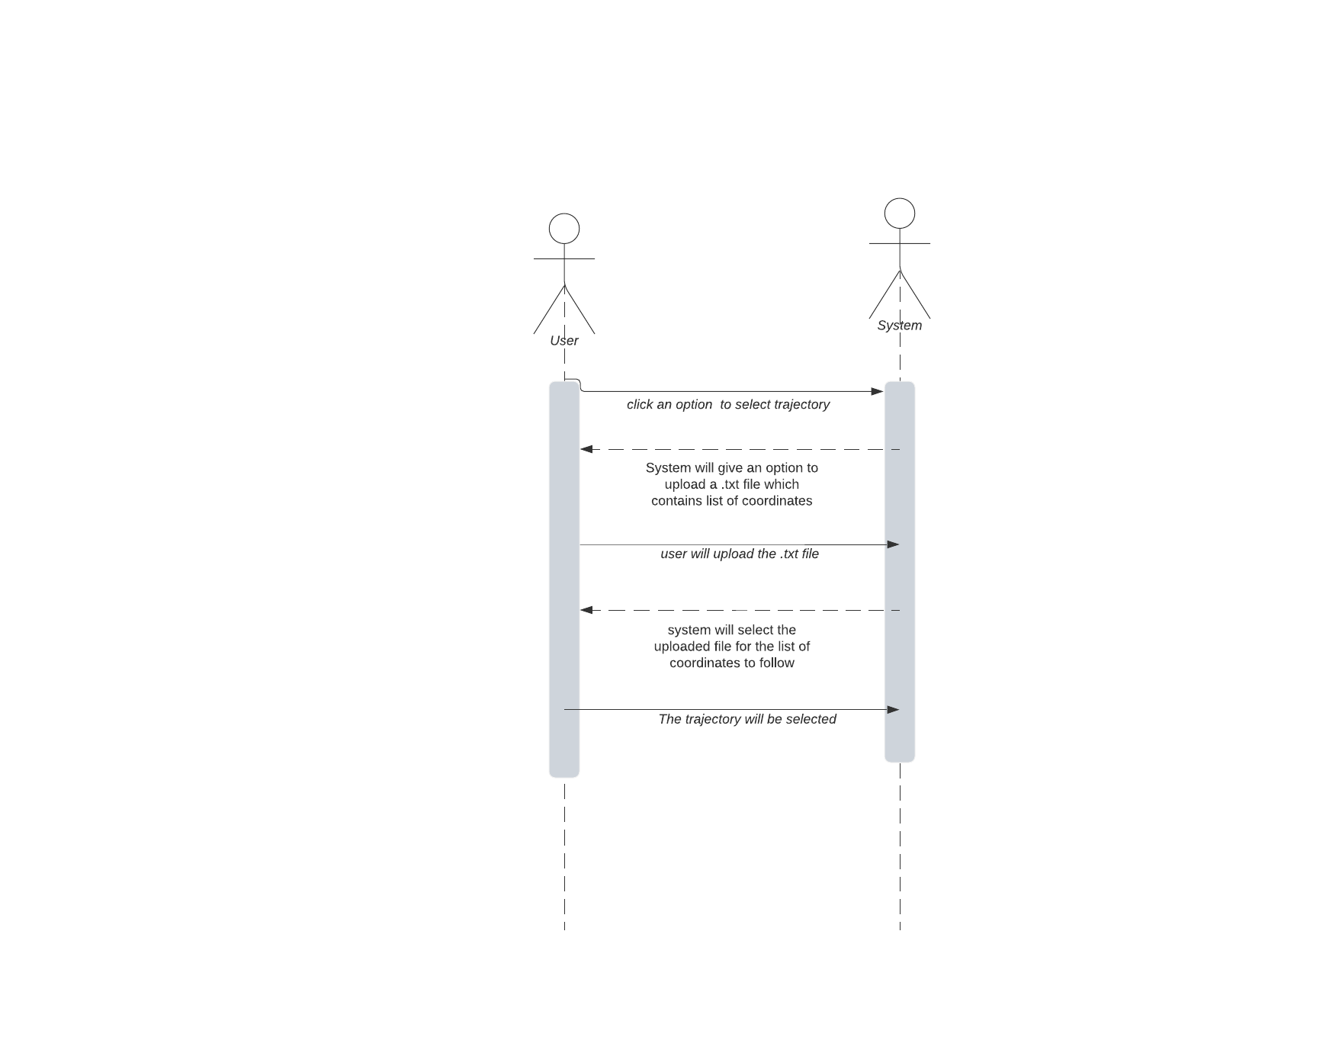
System Sequence Diagrams -Selection of Trajectory

Slide 9
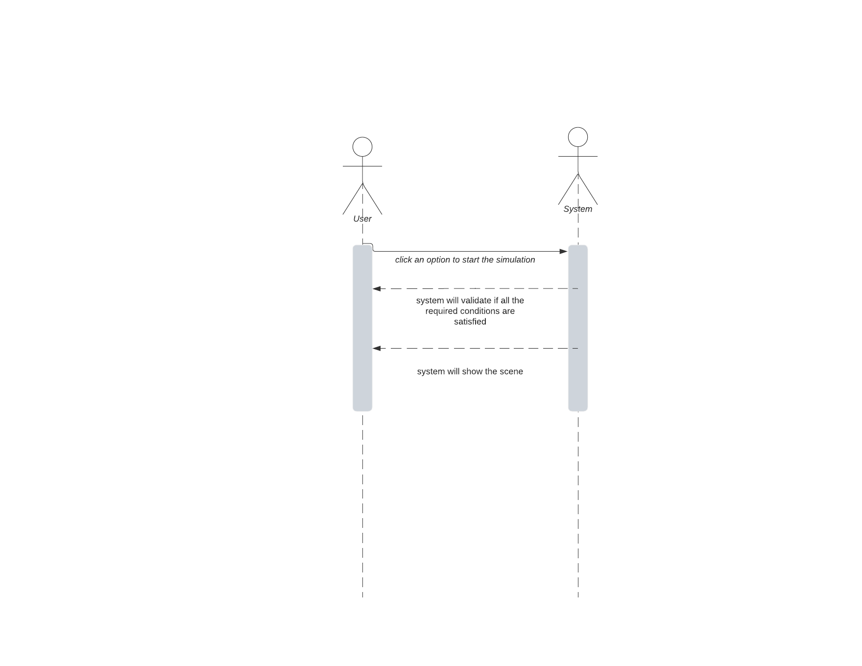
System Sequence Diagrams -Scene Generation

Slide 10
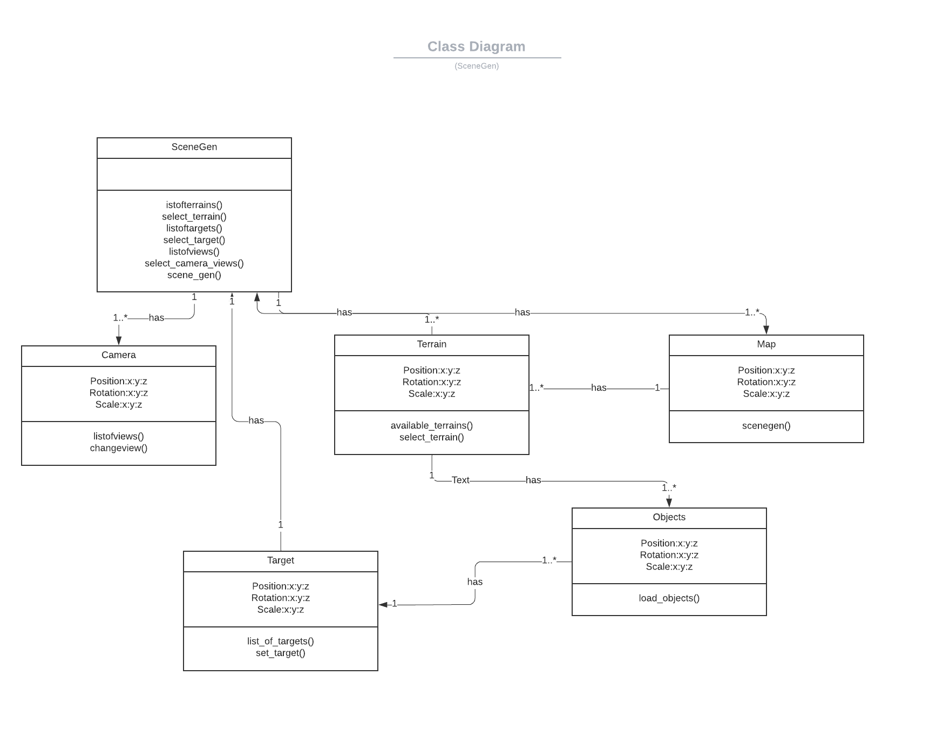
Class Diagram

Slide 11
Work-Breakdown Structure
TIME DIStRIBUTION | WORK DIVISION | CONTRIBUTIONS
11th-30th October | Working on the GUI of the application and making new on unity 3D | Abbad, Hamza, Shabih
1st-20th November | Selection of trajectory | Hamza , Abbad
21st-present | Implementation of scene generation in the application. | Abbad, Shabih

Slide 12
FUTURE FYP PLAN
DATASET COLLECTION AND MODEL TRAINING
TESTING, REVISIONS AND IMPROVEMENTS
In this iteration we will be generating dataset from the scene-gen application and training an AI model.
We will do the testing in NESCOM lab and do revisions and improvements in this iteration
Iteration - 3
Iteration - 4

Slide 13
Demonstration of Application

Slide 14
Any Questions?

